Slide 1
OPERATORS & CONTROL FLOW

Slide 2
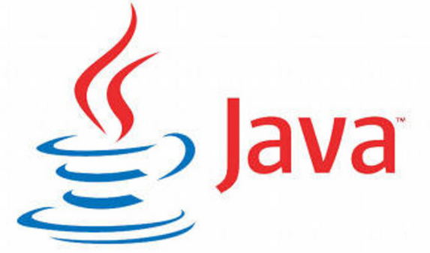
Learning Objectives for Operators
Arithmetic Operators
Increment or Decrement Operator
Relational Operators
Equality Operators
Logical operators
Short-circuit(or conditional) operators
Ternary operator
Assignment Operators
Type Casting
Selection Statements
Iteration Statements
Transfer Statements

Slide 3
OPERATORS
Arithmetic Operators
Relational Operators
Increment or Decrement Operators
Logical Operators
Assignment Operators
Ternary Operators

Slide 4
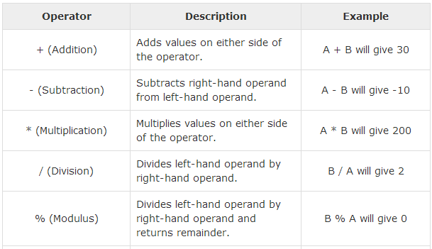
Arithmetic OPERATORS

Slide 5
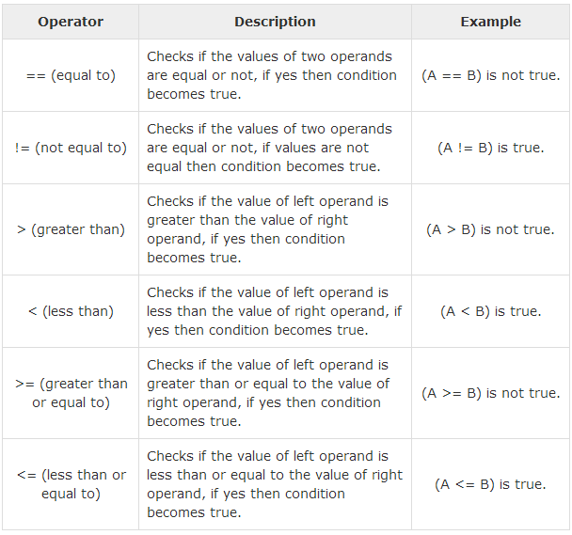
Relational OPERATORS

Slide 6
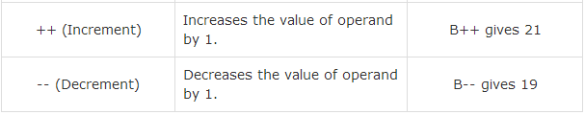
Increment and Decrement OPERATORS

Slide 7
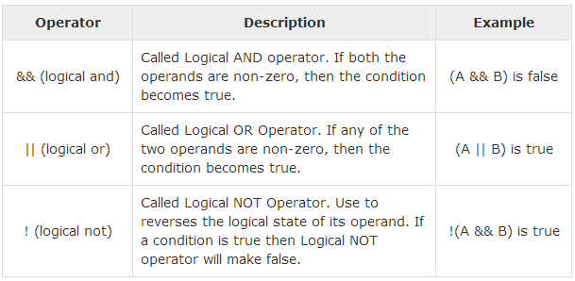
Logical OPERATORS

Slide 8
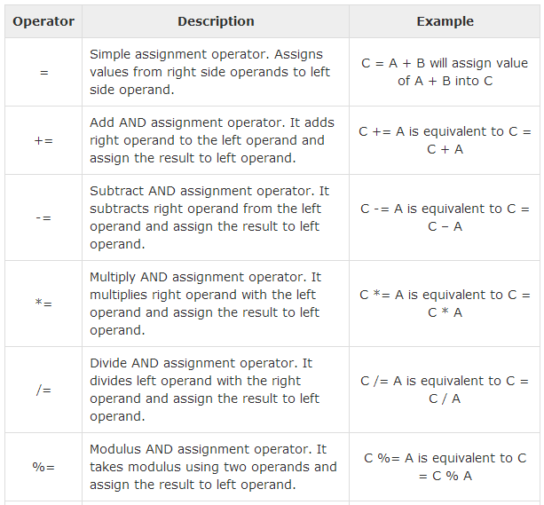
Assignment OPERATORS

Slide 9
Java array is an object the contains elements of similar data type. It is a data structure where we store similar elements. We can store only fixed set of elements in a java array.
Array in java is index based, first element of the array is stored at 0 index.
Ternary or Conditional OPERATOR
Conditional Operator ( ? : )
Conditional operator is also known as the ternary operator. This operator consists of three operands and is used to evaluate Boolean expressions. The goal of the operator is to decide, which value should be assigned to the variable.
The operator is written as
variable x = (expression) ? value if true : value if false

Slide 10
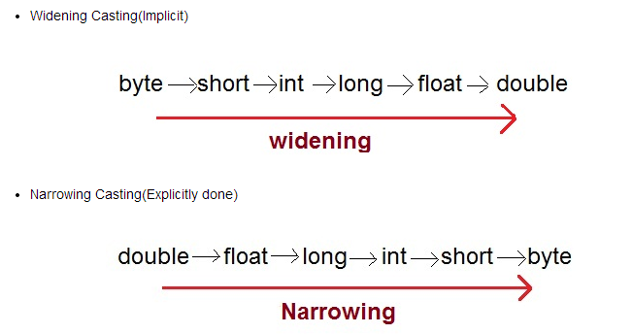
Java array is an object the contains elements of similar data type. It is a data structure where we store similar elements. We can store only fixed set of elements in a java array.
Array in java is index based, first element of the array is stored at 0 index.
Type CASTING
Implicit Casting [Java Compiler Auto]
Explicit Casting [Programmer]

Slide 11
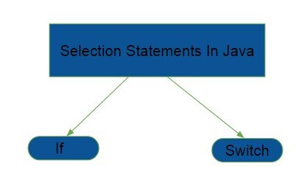
Java array is an object the contains elements of similar data type. It is a data structure where we store similar elements. We can store only fixed set of elements in a java array.
Array in java is index based, first element of the array is stored at 0 index.
Selection STATEMENT
→ If statement is a conditional branch statement. This is a two way branch statement. Depending upon the whether a condition is true or false, the corresponding code is executed.
→ Switch statement is a multiway branch statement. Depending upon the value used for switching, the corresponding code is executed.

Slide 12
Java array is an object the contains elements of similar data type. It is a data structure where we store similar elements. We can store only fixed set of elements in a java array.
Array in java is index based, first element of the array is stored at 0 index.
Iteration STATEMENT
Iteration statements cause statements (or compound statements) to be executed zero or more times.
Loops are basically means to do a task multiple times, without actually coding all statements over and over again.
Loops in Java are mainly of three types :- 1. 'while' loop 2. 'do while' loop 3. 'for' loop

Slide 13
Java array is an object the contains elements of similar data type. It is a data structure where we store similar elements. We can store only fixed set of elements in a java array.
Array in java is index based, first element of the array is stored at 0 index.
Transfer STATEMENT
Transfer statement in Java are mainly of three types 1. break 2. continue 3. return

Slide 14
What are we learning in Next Chapter ?
Package declaration
Accessibility modifiers
Simple Imports & Static Imports
Input From User

Slide 15
Thank You !

